Slide 1
PRECONDITIONING TRAINER PTD-P1
Guangdong Edosci Technology Company LTD

Slide 2
CONTENTS
01
Product Introduction
02
Efficacy
03
Indications
04
Effects
05
Benefits
06
Contraindications/Populations Not Suitable for Using

Slide 3
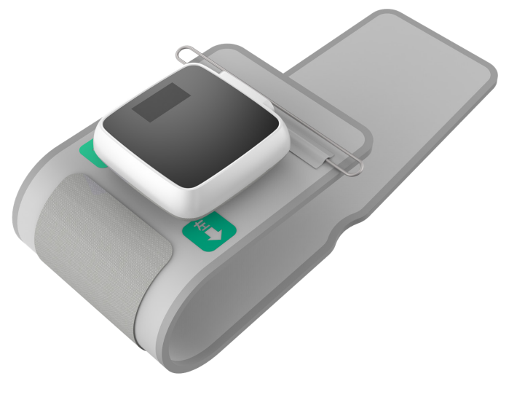
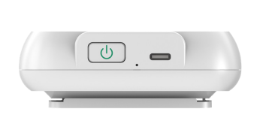
I. Product Introduction
1. Product Composition
Hidden Display Screen
Device Body
Cuff Wearing Direction Indicator
Cuff
Power Button
Power Port

Slide 4
Parameters(Model：PTD-P1)
Pressure Measurement Range | 0~260mmHg
Pressure Measurement Error Range | （Dynamic Pressure）±3 mmHg （Static Pressure）±4mmHg
Pulse Measurement Range | 40~199 Pulse/Minute（Accuracy±5%）
Preconditioning Training | Automatically increases pressure by 40mmHg with a 5% error rate, detects real-time blood pressure after 5 consecutive training sessions
Color of Device Body | Black and White
Cuff Size | Length：54cm,Width：13.5cm, Applicable Arm Circumference of Cuff Airbag：22~36cm
Dimensions | Length-Width-Height: 9cm*9cm*3cm
Functions:
1. Pressure Unit Switching：kPa/mmHg, mmHg is the default unit at first startup.
2. Overpressure Protection: Automatically release pressure once air pressure exceeds 295 mmHg (in about 0.02 seconds).
3. Automatic Shutdown: ①Automatically shut down if there is no operation within approximately 60 seconds after measurement, or after an error is reported within approximately 30 seconds. ②Self-protection time when the cuff is not tied and inflated: within 60 seconds.
4. Heartbeat Prompt Sound & heartbeat symbol flashing on the screen.

Slide 5
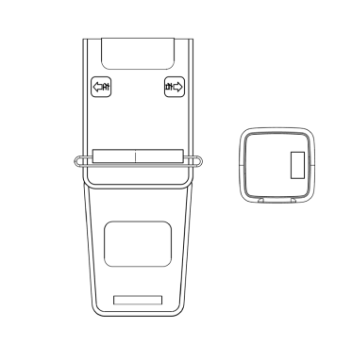
Repeated measurements may cause symptoms such as congestion and swelling. Frequent repeated blood pressure measurements cannot obtain accurate results. The interval between two measurements should be at least 10 minutes. The cuff should not be inflated for a long time, otherwise symptoms such as congestion and numbness may occur in the arm.
2. Product Description and Usage
This product consists of a host and a cuff,
suitable for measuring the systolic pressure, diastolic pressure,
and pulse rate of adults using the oscillographic method.
Notes:
Please rest quietly for 5 minutes before each measurement.
During training, lie flat or sit semi-upright, and keep both upper limbs and the heart at the same level, while maintaining a relaxed state.
Do not interrupt the training process, and keep the entire training process complete.
Stop training immediately if you feel uncomfortable during the training process.

Slide 6
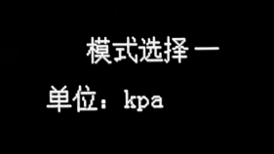
3. Screen Display and Measurement Method
一、产品介绍
3.1 Screen Display Content
Bluetooth Connection Status Indicator
Monitoring Mode Status Indicator
Charging Status Indicator
Battery Level
Date/Time
Operation Tips
Systolic Pressure
Diastolic Pressure
Pressure Unit
Pulse Rate
/Minute
Unit Setting
Error Prompt

Slide 7
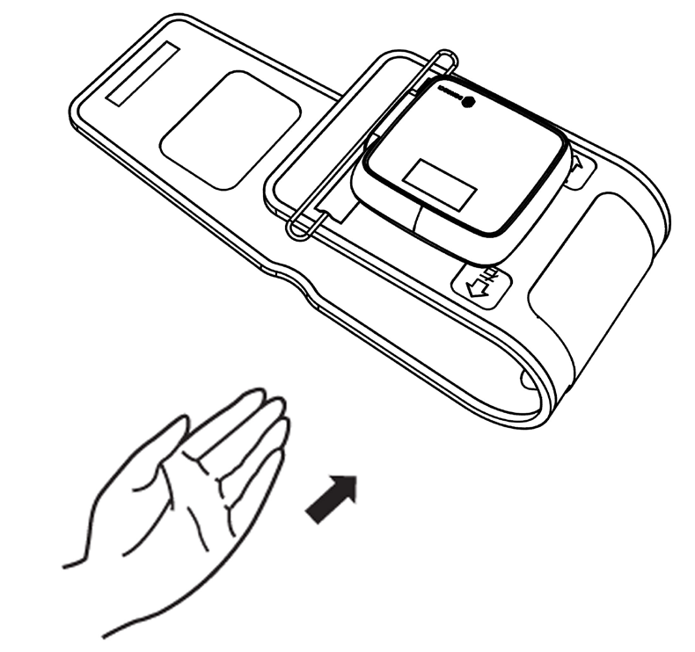
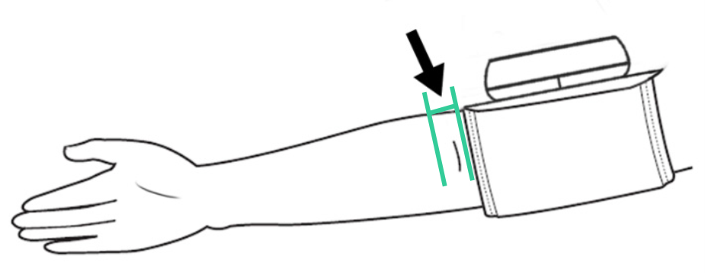
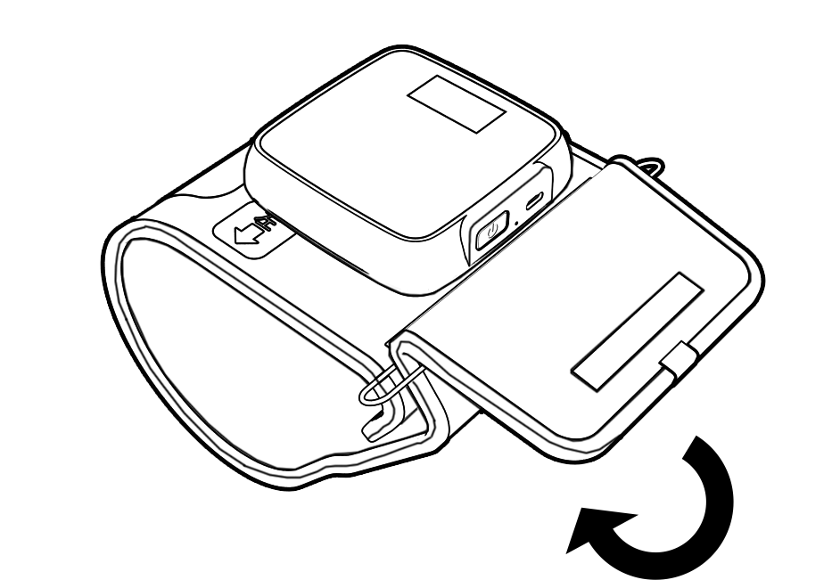
3.2 Mesuring Steps
3.测量方法
Step ①: Thread the cuff through the metal loop and insert your arm into the cuff.
Insert your arm into the cuff with the pointing to the right and the pointing to the left.
The correct position of the cuff is 1-2cm above the inside of your elbow joint.
Step ②: Adjust the cuff to the correct position and tighten it.
Step ③: Attach the Velcro on the cuff to secure it in place. Wrap the cuff tightly around your arm without any gaps between your arm and the cuff.

Slide 8
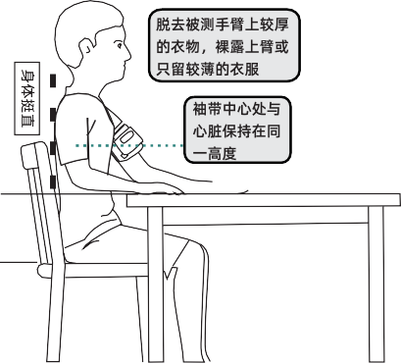
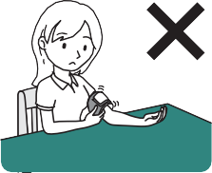
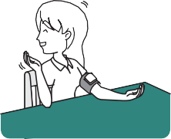
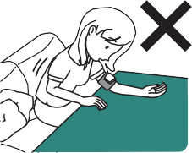
The center of the cuff should be at the same height as your heart.
Starting the measurement
Remove any thick clothing on the arm to be measured and expose your bare arm or wear thin clothing.
① Sit down in the correct posture and remain calm.
Sitting upright in a chair, the ideal height difference between the table and the chair is 25 to 30 centimeters
Incorrect measurement methods:
Cuff is wrapped too loosely
Moving your body or talking during the measurement
Leaning forward

Slide 9
Starting the measurement
Before wrapping the cuff for measurement, pay attention to the following points:
Both left and right arms can be measured, but the measurement results may vary between the two arms due to personal conditions. Therefore, please use the same arm for measurement every time.
Measure your bare arm or wear close-fitting thin clothing.
Measure in a room with a suitable temperature.
Do not roll up your sleeves for measurement when wearing thick clothing. Take off your clothing and then measure.
Do not use too much force during measurement to avoid excessive pressure that may damage blood vessels.
② Press the button on the device to start the automatic measurement.
a) During the measurement, please maintain a natural posture, do not move your body, and remain calm.
b) Do not touch the cuff during the measurement.
c) If you want to rewrap the cuff, stop the measurement first.
d) If you want to stop the measurement, press the button and the air in the cuff will be released.
e) If the pressure is insufficient, the screen will display an error message. Adjust the cuff and remeasure.
③ After the measurement is complete, the screen will display the measurement result.

Slide 10
Perform Vascular Training
1. Measure blood pressure first.
In the power-off state, press the button to turn on the device, after the screen shows the Logo, then press the button again to start blood measuring. The screen will display the blood pressure value while the cuff inflating.
2. After the blood pressure value is displayed on the screen, long-press the button for 2 seconds while the blood pressure value is still displayed, and the Logo will flash four times then the device jumps to training mode.
3. In training mode the device starts inflating. When the pressure reaches the matching pressure, it stops pressurizing and maintains a constant pressure for 5 minutes. After 5 minutes, the cuff pressure is released automatically, and a 5-minute rest is taken. This process is repeated for a total of 5 times. Each whole training session lasts 50 minutes by default.
Other functions
1. A new unit switching operation method is added. Press the pinhole button to enter the unit switching interface, use the main button to switch units, and use the pinhole button to confirm and exit.

Slide 11
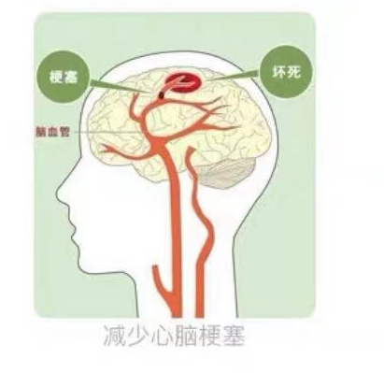
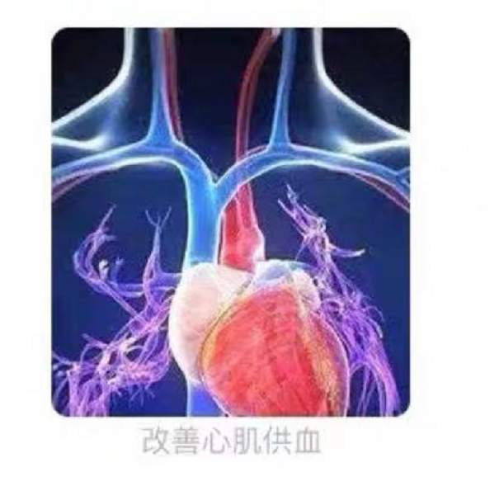
II. Effects
1. Reduces the incidence of stroke and cerebral infarction, and helps to recover from hemiplegic limb paralysis.
2. Dilates coronary arteries and peripheral blood vessels, increases coronary blood flow, improves myocardial blood supply, prevents angina attacks, and relieves angina symptoms.

Slide 12
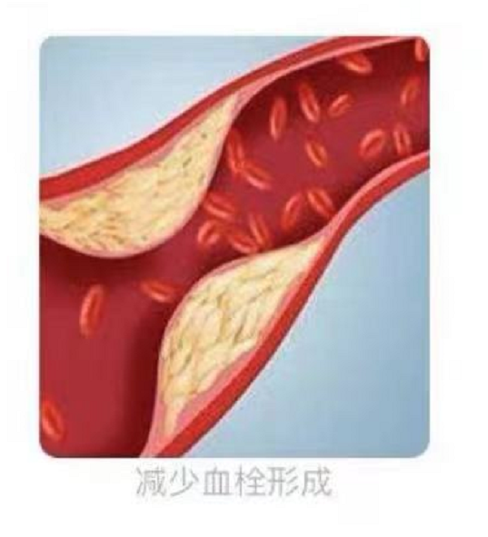
3. Reduces thrombus formation, protects vascular endothelial function, reduces myocardial infarction area after coronary artery stenting, promotes myocardial vascular regeneration, and lowers blood pressure.
4. Improves exercise capacity, relieves ischemic hypoxia response, and has the effects of exercise training, significantly improving sleep quality.
图三
图四

Slide 13
III. Indications
Hypertension, diabetes, coronary heart disease, hyperlipidemia, stroke, cerebral ischemia, cerebrovascular disease, cerebral arteritis, perioperative assistance, obesity, smoking and alcohol abuse, cerebral smoke syndrome, Parkinson's disease, sedentary people, overwork, high-altitude hypoxia, etc.
Through external intervention, the limb artery and venous blood flow are briefly and regularly blocked, and a large amount of protective factors such as adenosine, bradykinin, and nitric oxide are activated instantly. By repeatedly experiencing short-term ischemia and reperfusion, the limb achieves the effect of preconditioning.
After 7-15 days of tolerance, some effects will be felt, and a course of treatment usually lasts 3-6 months.
Tips: Endogenous substances
Adenosine is an endogenous nucleoside widely distributed in human cells, involved in myocardial energy metabolism, and also involved in dilating coronary blood vessels and increasing blood flow.
Bradykinin is a peptide that causes vasodilation and enhances vascular permeability. It can reduce the size of the infarction area of ​​acute ischemic-reperfused myocardium and can cause a decrease in blood pressure.
Nitric oxide can promote blood circulation, strengthen vascular and systemic blood circulation, and promote the operation of the heart, brain, and microcirculation.

Slide 14
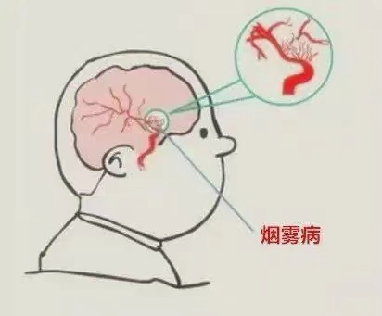
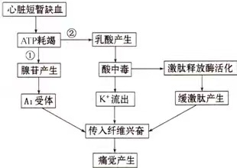
knowledge acquisition: Brain Fog Syndrome
Cerebral vascular malformations can lead to vascular occlusion, causing cerebral ischemia. The imaging appearance of blood vessels is changed in a smoky pattern.
Brief ischemia of the heart
Lactic acid production
ATP depletion
Acidosis
Activation of kinin-releasing enzymes
Adenosine production
Potassium efflux
Kinin production
A1 receptor activation
The process of adenosine and bradykinin production
Excitation of afferent fibers
Pain

Slide 15
4. Effects and Results
Patients with ischemic cerebrovascular disease show abnormal brain oxygen metabolism and blood supply status. Therefore, improving the brain oxygen metabolism and blood supply status of patients is the focus of treatment. Cerebrovascular disease is the main cause of disability in adults.
Case study 1:
40 patients with common early symptoms of cerebral infarction, including 36 men and 4 women, with an average age of 66.5 ± 2.3 years. Clinical symptoms of the patients included tinnitus, weakness, numbness of limbs, intermittent dizziness, blurred vision, and diplopia, which are common early symptoms of cerebral infarction and cerebral thrombosis.
The patients underwent remote ischemic preconditioning training with a pressure cuff on the upper arm, and the pressure was increased to 160-180 mmHg (1 mmHg = 0.133 kPa) for 5 minutes(then completly released), followed by a 5-minute rest and another round of treatment, with 5 rounds constituting 1 treatment session, which was conducted once in the morning and once in the evening for 6 months.
Results: The 40 patients showed significant clinical improvement after remote ischemic preconditioning training. As shown in the table below, there was a significant increase in arterial blood flow velocity before and after treatment (P < 0.05).

Slide 16
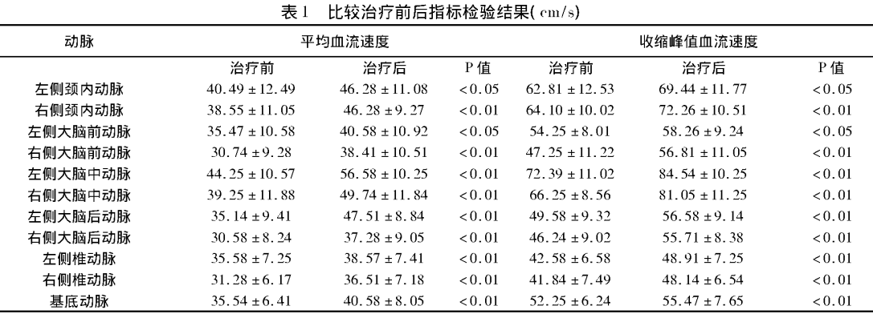
Comparing test results of indicators before and after treatment(cm/s)
Table 1
Artery
Mean Blood Flow Velocity
Systolic Peak Blood Flow Velocity
Before
After
Before
After
Left Internal Carotid Artery
Right Internal Carotid Artery
Left Anterior Cerebral Artery
Right Anterior Cerebral Artery
Left Middle Cerebral Artery
Right Middle Cerebral Artery
Left Posterior Cerebral Artery
Right Posterior Cerebral Artery
Left Vertebral Artery
Right Vertebral Artery
Basilar Artery
Conclusion: Remote ischemic preconditioning training induces organs outside the ischemic organ to protect against subsequent lethal ischemia and hypoxia after receiving brief, reversible ischemia-hypoxia stimulation. It has the advantages of being simple, safe, and effective in clinical practice without the risk of surgical treatment. Patients experienced a reduction in symptoms such as numbness of limbs and intermittent dizziness within 3-6 months of use.
* P-value is a decreasing index of the credibility of the results. A difference is statistically significant if P < 0.05.

Slide 17
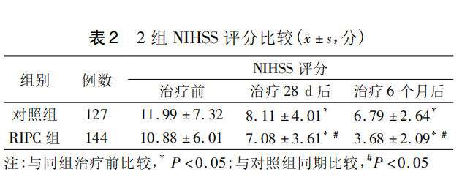
Case study 2
The effect of Remote Ischemic Preconditioning (RIPC) on the clinical prognosis and expression level of serum inflammatory factors in patients with cerebral infarction.
Method: 271 patients with cerebral infarction were collected as study subjects and randomly divided into RIPC group and control group. The RIPC group received limb ischemic preconditioning training and drug treatment, while the control group received only drug treatment.
Conclusion: As shown in Tables 2 and 3, the NIHSS score improvement in the RIPC group was better than that in the control group after 28 days and 6 months of treatment (P < 0.05); the incidence of cerebral ischemic recurrence in the RIPC group was lower than that in the control group (P < 0.05).
NIHSS scoring
NIHSS:
A scoring system used to evaluate the severity of cerebral infarction in stroke patients. The lower the score, the milder the condition of cerebral infarction.
Table 2
Patients
Before
After(28 d/6 months)
the control group
The RIPC group
The changes in the expression levels of inflammatory factors before and after treatment in 2 groups of patients
Table 3
After 28 days
After 28 days
After 28 days
After 28 days
Before
Before
Before
Before
the control group
the RIPC group

Slide 18
Comparison of Medications, Prices, and Effects
Medication | Unit Price | Effects
Aspirin Enteric-Coated Tablets (100mg30 tablets) for 30 days | 21.5CNY | Used to prevent recurrent myocardial infarction and secondary stroke
Clopidogrel Hydrogen Sulfate Tablets (75mg 7 tablets) for 7 days | 31CNY | Suitable for atherosclerosis and unstable angina
Vasorel (Trimetazidine hydrochloride tablets 20mg*30 tablets) | 51CNY | For angina pectoris and stable angina
Compound Salvia Tablets (200 tablets 0.32g) for 22 days | 28CNY | Promotes blood circulation, removes blood stasis, and relieves pain. Suitable for coronary heart disease, angina pectoris, etc.
knowledge acquisition:
Medicine is like a double-edged sword. Our liver is responsible for detoxifying drugs. Long-term use of drugs will certainly damage our liver and kidneys, and much of this damage is irreversible.The main side effects include gastrointestinal reactions, allergic reactions, and liver and kidney dysfunction.

Slide 19
V. Four Major Benefits
Benefits
Assistive treatment during acute phase: alleviate cardiovascular and cerebrovascular disease symptoms, promote recovery of cardiovascular and cerebral function.
Assistive treatment during health phase: reduce the recurrence rate of cardiovascular and cerebrovascular disease, dizziness, headache, insomnia, tinnitus, chest tightness, and palpitations.
Prevent and reduce disease occurrence: reduce the incidence of cardiovascular and cerebrovascular disease in high-risk populations.
Prevent high altitude sickness: achieve high altitude preadaptation.
Significant Effects on 4 Types of People
High-risk individuals for stroke, including those with abnormal blood pressure, blood lipids, blood sugar, a family history of stroke, or a history of stroke themselves.
Patients with poor efficacy of drug treatment and unsuitable for surgical treatment.
Patients who have undergone surgery and have recurrence.
Elderly people who are not suitable for large-scale use of drugs or surgery.
By applying cyclic pressure changes on the upper limbs of the human body through physical therapy, the opening and closing time of blood vessels can be artificially controlled, and the ischemic tolerance of tissues and organs can be enhanced.
Training - targeting the blood.
Completing a whole preconditioning training is equivalent to 5 kilometers of blood circulation exercise.

Slide 20
VI. Populations Not Suitable for Using
Individuals with the following symptoms should not use this product for pre-adaptation training:
1. Serious, uncontrolled organ diseases such as brain, lung, liver, kidney, etc.;
2. Uncontrolled infections and fevers of unknown origin;
3. Coagulation dysfunction or active visceral bleeding;
4. Malignant tumors;
5. Infants, young children, and pregnant women;
6. Patients with peripheral vascular disease;
7. Patients with severe primary hypertension whose blood pressure is not controlled within the normal range;
8. Patients with vasculitis, Raynaud's disease, diabetic foot/hand, capillary fragility, or multiple peripheral neuropathy.
Friendly reminder: If your systolic blood pressure measured is ≥180mmHg, your blood pressure is too high and you are not suitable for training. It is recommended that you seek medical attention as soon as possible, or take medication to stabilize your blood pressure to the normal range before training.
knowledge acquisition:
Raynaud's disease is characterized by cold limbs feeling, numbness, and occasional pain in the hands and feet during an attack. With the joint between the palm and fingers as the boundary, during a typical attack, the fingers become cold, pale, purple, and then red.

Slide 21
Contact us
Ming Liang
Cell:17159652315
Guangdong Edosci Technology Company LTD:
Room 408, building B, Doctoral & Post-doctoral Entrepreneurship & Innovation Base, Zumiao, Chancheng district, Foshan city, Guangdong province, PRC

